Slide 1
Burghfield Community Hub
Wednesday, June 07, 2017

Slide 2
656
Total Responses
Date Created: Wednesday, February 15, 2017
Complete Responses: 655

Slide 3
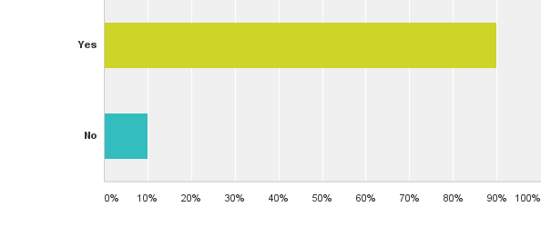
Q1: Would you like to see a central Community Hub within Burghfield?
Answered: 651 Skipped: 5

Slide 4
Q1: Would you like to see a central Community Hub within Burghfield?
Answered: 651 Skipped: 5

Slide 5
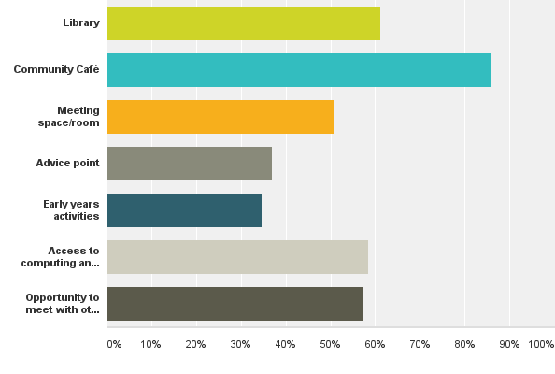
Q2: Which of the following would you like to see provided within the proposed Community Hub?
Answered: 632 Skipped: 24

Slide 6
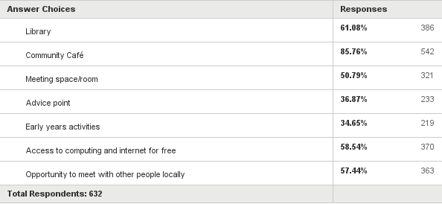
Q2: Which of the following would you like to see provided within the proposed Community Hub?
Answered: 632 Skipped: 24

Slide 7
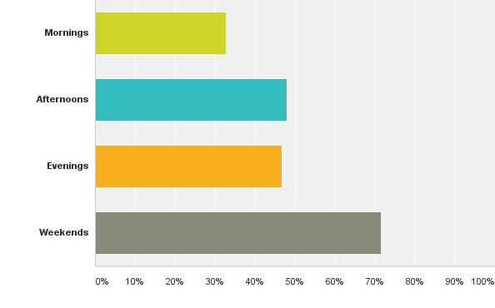
Q5: What times are you most likely to use the Community Hub?
Answered: 624 Skipped: 32

Slide 8
Q5: What times are you most likely to use the Community Hub?
Answered: 624 Skipped: 32

Slide 9
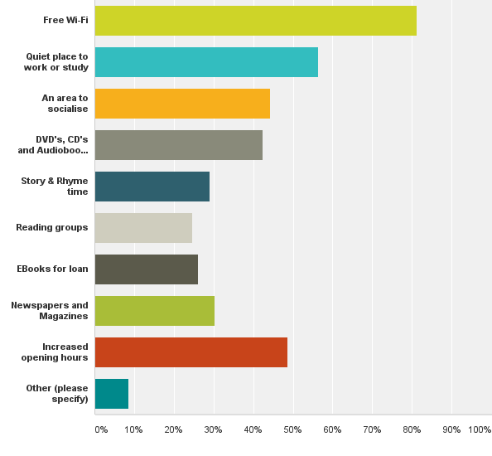
Q6: If the Library is to become an integral part of the hub, what additional services would you like to see?
Answered: 629 Skipped: 27

Slide 10
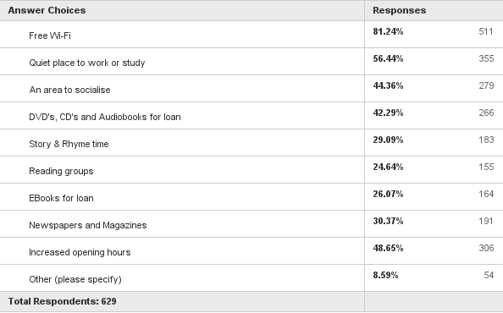
Q6: If the Library is to become an integral part of the hub, what additional services would you like to see?
Answered: 629 Skipped: 27

Slide 11
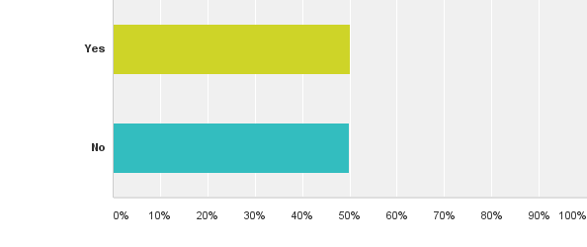
Q7: Do you feel the current library meets the needs of local residents?
Answered: 618 Skipped: 38

Slide 12
Q7: Do you feel the current library meets the needs of local residents?
Answered: 618 Skipped: 38

Slide 13
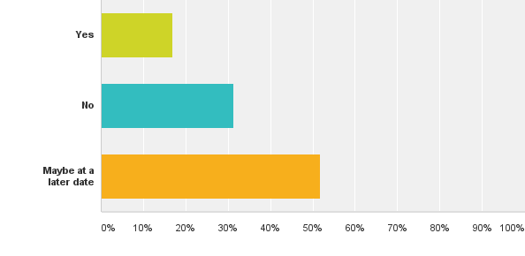
Q8: Would you be willing to volunteer to work with any of the potential Hub Service providers within the proposed hub in Burghfield?
Answered: 644 Skipped: 12

Slide 14
Q8: Would you be willing to volunteer to work with any of the potential Hub Service providers within the proposed hub in Burghfield?
Answered: 644 Skipped: 12

Slide 15
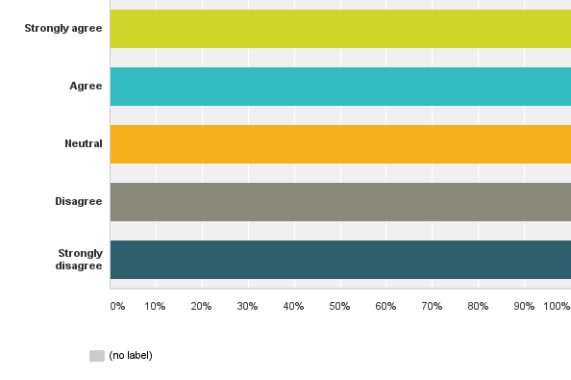
Q9: Do you agree/disagree with the following statement:Burghfield deserves a facility that can become the focus of community life, caters for the needs and interests of everyone in the parish and is able to offer sporting, leisure and social activities in a flexible way.
Answered: 647 Skipped: 9

Slide 16
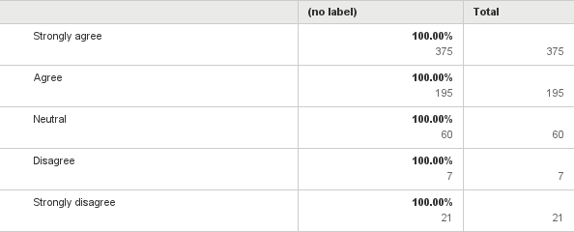
Q9: Do you agree/disagree with the following statement:Burghfield deserves a facility that can become the focus of community life, caters for the needs and interests of everyone in the parish and is able to offer sporting, leisure and social activities in a flexible way.
Answered: 647 Skipped: 9

Slide 17
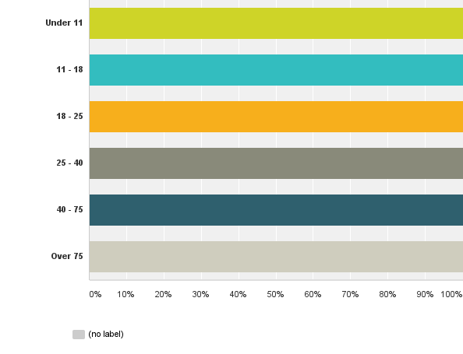
Q10: Please specify which age group you are:
Answered: 646 Skipped: 10

Slide 18
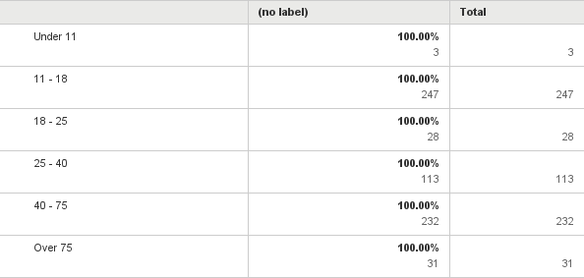
Q10: Please specify which age group you are:
Answered: 646 Skipped: 10

